Slide 1

Defending and Securing Systems
Monitoring and Securing the DFI Environment

Slide 2
Securing a Computer System
Scenario:
Douglas Financials Inc (DFI from here forward) has experienced successful growth and as a result is ready to add a Security Analyst position. Previously Information Security responsibilities fell on our System Administration team. Due to compliance and the growth of DFI we are happy to bring you on as our first InfoSec employee! Once you are settled in and finished orientation we have your first 2-Weeks assignments ready.

Slide 3

Week 1

Slide 4
Connect - Instructions
All of the subsequent steps will take place in the DFI environment. Use the Windows 10 workstation to connect with the Windows server provided. [Please Provide Screenshots on the next slide as evidence that you completed this step.]

Slide 5
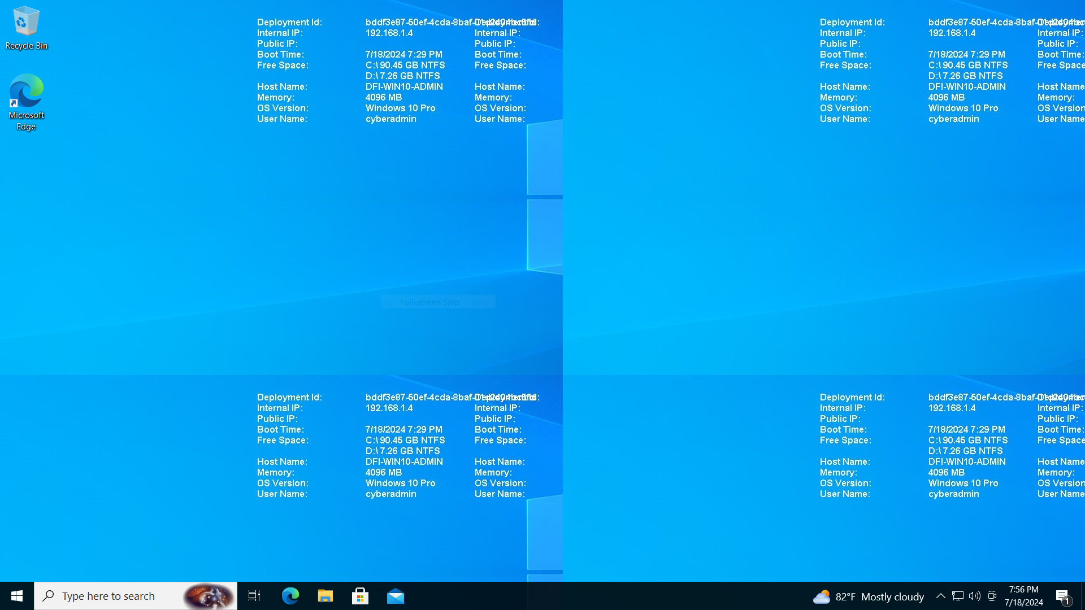
Connect - Evidence
[Please Provide Screenshots here as evidence that you completed the step listed on the previous slide. You may need to duplicate this slide to include all of your screenshots]

Slide 6
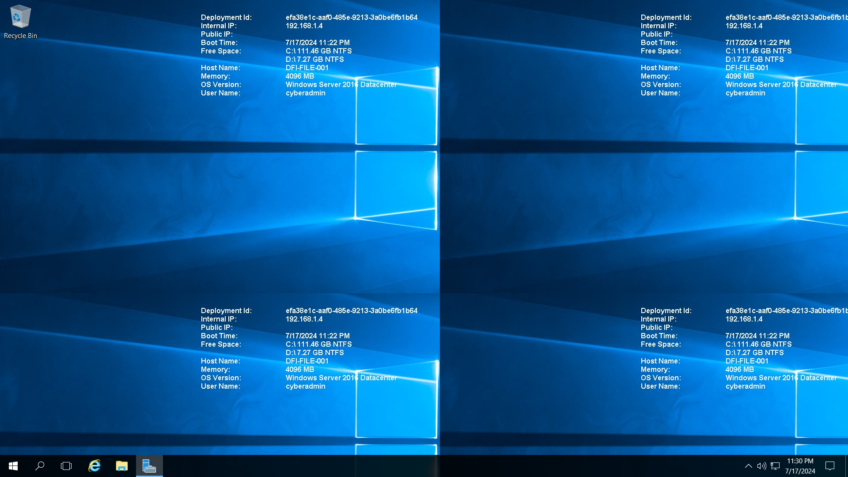
Connect - Evidence
[Please Provide Screenshots here as evidence that you completed the step listed on the previous slide. You may need to duplicate this slide to include all of your screenshots]

Slide 7
2. Security Analysis Instructions
DFI has an excellent SysAdmin team, but they have been focused on system reliability and scaling to meet our growing needs and as a result, security may not be as tight as we'd like. Your first assignment is to familiarize yourself with our file and application servers. Please perform an analysis of the Windows server and provide a written report detailing any security configuration issues found and a brief explanation and justification (5 sentences at least) of the changes you recommend. DFI is a PCI compliant organization and will likely be Sarbanes-Oxley in the near future. Use NIST, Microsoft, Defense-in-Depth, Principle of Least Privilege and other resources to determine the changes that should be made. Note changes can be to add/remove/change services, permissions and other settings. Defense-in-Depth documentation. NIST 800-123 (other NIST documents could also apply.) Looking at the following requirements, specifically: Folder Permissions (that are incorrectly granted) Roles Changes (disabled/enabled) Services changes (disabled/enabled) Tip: Do not miss the security permissions on the HR Directory. Write your analysis on the next slide.

Slide 8
2. Security Analysis Evidence
Write your analysis below.
 | File Permissions That Need to be Modified IT Folder: Issues and Recommendations: CREATOR OWNER Permissions: CREATOR OWNER has Full Control but only on subfolders and files. This might not be necessary and could be reduced to Modify or Read & Execute if full control isn't required. Missing Specific User Permissions: There may be a need to provide specific permissions to individual users or groups, limiting full control access to only necessary users. Accounting Folder: Issues and Recommendations: AmyIT Permissions: AmyIT has Read & Execute permissions which seem appropriate for access. Ensure this user doesn't need higher privileges. BUILTIN\Administrators Permissions: Full Control is given for this folder only. If subfolders and files management is needed, update permissions to reflect that. HR Folder: Issues and Recommendations: BUILTIN\Users Permissions: There are both Special and Read & Execute permissions. Consolidate permissions for clarity. Remove the Special permissions if not necessary. CREATOR OWNER Permissions: Similar to the IT folder, consider reducing permissions for CREATOR OWNER to Modify or Read & Execute if full control isn't essential. Full Control Review: Ensure Full Control is only assigned to necessary users and groups to prevent unauthorized modifications. Review Permissions: Ensure that permissions are set according to the principle of least privilege. Modify Permissions: If users have excessive permissions (e.g., Full Control), consider restricting them to Read or Modify as necessary. Audit Permissions: Regularly audit permissions to ensure compliance with security policies.

Slide 9
2. Security Analysis Evidence
Write your analysis below.
 | Roles That Are Not Needed on Windows Server : Active Directory Certificate Services: If not used for managing certificates, this role can be removed. Remote Access: If there are no remote access needs, this role may be unnecessary. Web Server (IIS): If the server is not hosting any web applications, this role can be disabled. Windows Deployment Services: If there are no deployment needs, this role can be removed. File and Storage Services: If file sharing is not required, consider removing this role.

Slide 10
2. Security Analysis Evidence
Write your analysis below.
 | Services That Should or Should Not Be Running: Services to Consider Stopping/Disabling: DHCP Server: If the server is not managing IP addresses, this service should be disabled. Active Directory Domain Services: If the server is not functioning as a domain controller, this service can be stopped. Windows Deployment Services: Disable if not in use. Essential Services to Keep Running: Hyper-V: If virtualization is in use, this service should remain active. DNS Server: If the server is handling DNS queries, this service is essential. File and Storage Services: Keep running if file sharing is required.

Slide 11
3. Firewall Rules - Instructions
DFI does not have a dedicated networking department just yet, once again these tasks normally fall under the SysAdmin group. Now that we have you as a security professional, you'll take over the creation of our firewall rules. We recently entered into a new partnership and require new IP connections. Using Cisco syntax, create the text of a firewall rule allowing a new DFI partner WBC International, access to DFI-File-001 & DFI-File-002 access via port tcp-9082. The first partner's IP is 21.19.241.63 and DFI-File-001's IP is 172.21.30.44. The second partner's IP is 21.19.241.64 and DFI-File-002's IP is 172.21.30.45. For this exercise assume the two IP objects have not been created in the firewall. Note* Use DFI-Ingress as the interface for the rule. For documentation purposes, please explain in 2-3 sentences the syntax for non-technical management on the change control board that meets weekly. Write the text of your firewall rule and explanation on the next slide.

Slide 12
3. Firewall Rules - Evidence
Write the text of your firewall rules and explanation below.
 | ! Create object for the first partner object network WBC-Partner1 host 21.19.241.63 ! Create object for DFI-File-001 object network DFI-File-001 host 172.21.30.44 ! Allow traffic from WBC-Partner1 to DFI-File-001 on port TCP-9082 access-list DFI-Access-List extended permit tcp object WBC-Partner1 object DFI-File-001 eq 9082 ! Create object for the second partner object network WBC-Partner2 host 21.19.241.64 ! Create object for DFI-File-002 object network DFI-File-002 host 172.21.30.45 ! Allow traffic from WBC-Partner2 to DFI-File-002 on port TCP-9082 access-list DFI-Access-List extended permit tcp object WBC-Partner2 object DFI-File-002 eq 9082 ! Apply the access list to the DFI-Ingress interface access-group DFI-Access-List in interface DFI-Ingress EXPLANAITION : To support our partnership with WBC International, we are setting up firewall rules that allow specific access to our file servers. We create network objects to identify the partner's IP addresses and our file servers. Then, we define rules to permit communication only on port TCP-9082, ensuring secure and controlled access. These rules are applied to the DFI-Ingress interface, allowing necessary access while maintaining the integrity and security of our network.

Slide 13
4. VPN Encryption Recommendation Instructions and Evidence
DFI is creating a payroll processing partnership with Payroll-USA, this will involve creating a VPN connection between the two. Research, and in in 3 to 5 sentences, recommend and justify an encryption solution for the connection that is using the latest available encryption for Cisco. Use the Cisco documentation as a guide
 | Write your VPN Encryption Recommendation here. For the VPN connection between DFI and Payroll-USA, you should secure it by running IPsec on top of IKEv2 with AES-256 encryption and SHA-2 for integrity using Diffie-Hellman Group 14 or higher. This configuration is documented by Cisco, because it acts as a highly secure mode that guarantees the privacy and accuracy of your key exchange process. It uses AES-256 for strong encryption and SHA-2 to ensure data integrity. Diffie-Hellman Group 14 or higher if referenced, improving key exchange security according to industry standards and maintaining a robust VPN connection secure encryption.

Slide 14
5. IDS Rule - Instructions
The System Administrator gave you a heads up that DFI-File-001 with an IP address of 172.21.30.44 has been receiving a high volume of ICMP traffic and is concerned that a DDoS attack is imminent. She has requested an IDS rule for this specific server. The VoIP Administrator is also concerned that an attacker is attempting to connect to her primary VoIP server which resides at 172.21.30.55 via TFTP. She has requested an IDS rule for this traffic. For documentation purposes, please explain the syntax in 3-5 sentences for non-technical management on the change control board that meets weekly. Write your answers on the next slide.

Slide 15
5. IDS Rule - Evidence
Write your answers below.
 | Write your System Admin rule and explanation here. alert icmp any any -> 172.21.30.44 any (msg:"Potential DDoS ICMP traffic to DFI-File-001"; threshold: type both, track by_src, count 50, seconds 10; sid:1000001; rev:1;) designed to detect potential DDoS (Distributed Denial of Service) attacks by monitoring ICMP (Internet Control Message Protocol) traffic to the DFI-File-001 server at IP address 172.21.30.44. The rule triggers an alert if more than 50 ICMP packets are sent from a single source within 10 seconds, indicating unusual activity that could suggest an impending DDoS attack.
 | Write your VoIP Admin rule and explanation here. alert udp any any -> 172.21.30.55 69 (msg:"Unauthorized TFTP connection attempt to VoIP Server"; sid:1000002; rev:1;) focused on the VoIP server at IP address 172.21.30.55, specifically monitoring for unauthorized attempts to connect via TFTP (Trivial File Transfer Protocol) on port 69. This rule will alert the system if any UDP traffic targeting the server on this port is detected, which helps prevent unauthorized access attempts that could compromise the VoIP infrastructure.

Slide 16
6. File Hash Verification - Instructions
A software vendor has supplied DFI with a custom application. They have provided the file on their public FTP site and e-mailed you directly a file hash to verify the integrity and authenticity. The hash provided is a SHA256. Hash: 7805EC4395F258517DFCEEED2B011801FE68C9E2AE9DB155C3F9A64DD8A81FF6 Perform a file hash verification and submit a screenshot of your command and output. The File is stored on the Windows 2016 Server in C Drive under DFI-Download. [Place your screenshot verification on the next slide.]

Slide 17
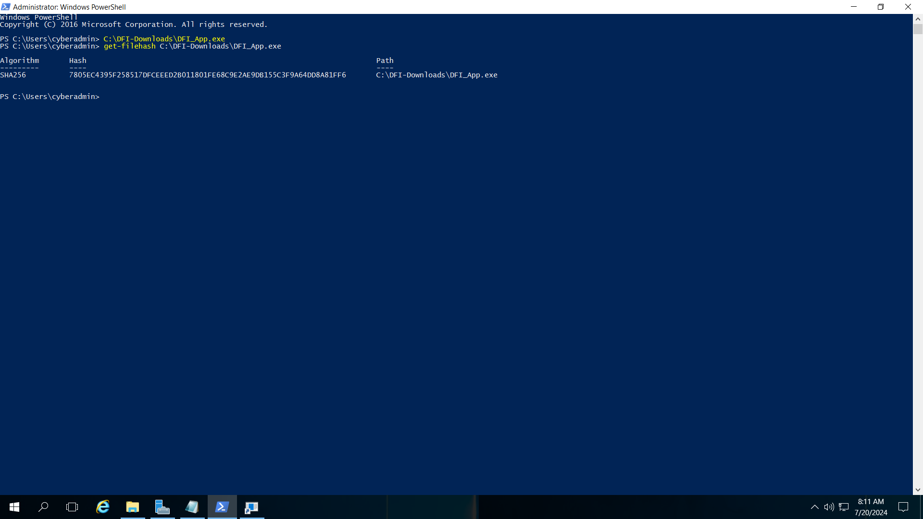
6. File Hash Verification
Place your screenshot verification below.

Slide 18
Week 2

Slide 19
7. Automation - Instructions
Now that you've performed a light audit and crafted Firewall and IDS Signatures we're ready for you to make some additional recommendations to tighten up our security. The IT Manager has tasked you with some introductory research on areas that could be improved via automation. Research and recommend products, technologies and areas within DFI that could be improved via automation. Recommended areas are: SOAR products and specifically what could be done with them Automation of mitigation actions for IDS and firewall alerts. Feel free to elaborate on other areas that could be improved. Complete the chart on the next slide including the area/technology within DFI and a proposed solution, with a minimum of 3 areas. Provide a brief explanation (at least one sentence each) for your choices.

Slide 20
7. Automation - Evidence
Complete the chart below.
 | DFI Area/Technology | Solution | Justification for Recommendation
 | Security Orchestration, Automation, and Response (SOAR) | implement a SOAR platform like Palo Alto Networks Cortex XSOAR or Splunk Phantom | SOAR platforms can automate incident response workflows, integrate multiple security tools, and provide automated playbooks to respond to threats efficiently. This reduces response time and human error.
 | IDS and Firewall Alerts | Use an automation tool like Tufin or FireMon to automatically apply policy changes | Automating the response to IDS and firewall alerts can prevent known threats in real-time by adjusting firewall rules or triggering alerts for further investigation without human intervention.
 | Patch Management | Deploy an automated patch management system such as Ivanti Patch Management | Automation in patch management ensures that all systems are updated promptly, reducing vulnerabilities and freeing IT staff from manual updates.
 | Threat Intelligence | Integrate threat intelligence feeds with a tool like Recorded Future | Automating threat intelligence collection and analysis can provide real-time updates on emerging threats, allowing for proactive defense measures.
 | User Behavior Analytics (UBA) | Implement a UBA tool like Exabeam to automate anomaly detection | UBA tools use machine learning to detect unusual user behavior, automatically identifying potential insider threats or compromised accounts based on deviations from normal patterns.

Slide 21
8. Logging RDP Attempts - Instructions
The IT Manager suspects that someone has been attempting to login to DFI-File-001 & DFI-File-002 via RDP. Prepare a report that lists unsuccessful attempts in connecting over the last 24-hours & 12 hours respectively. Using Powershell or Eventviewer, search the Windows Security Log for Event 4625 & 4626 respectively. Export to CSV. For your deliverable, open the CSV with Notepad and take a screenshot from your personal computer for your explanation. Then in 3-5 sentences, explain your findings, recommendations and justifications to the IT Manager. Place your screenshot on the following slide and the explanation on the slide after your screenshot.

Slide 22
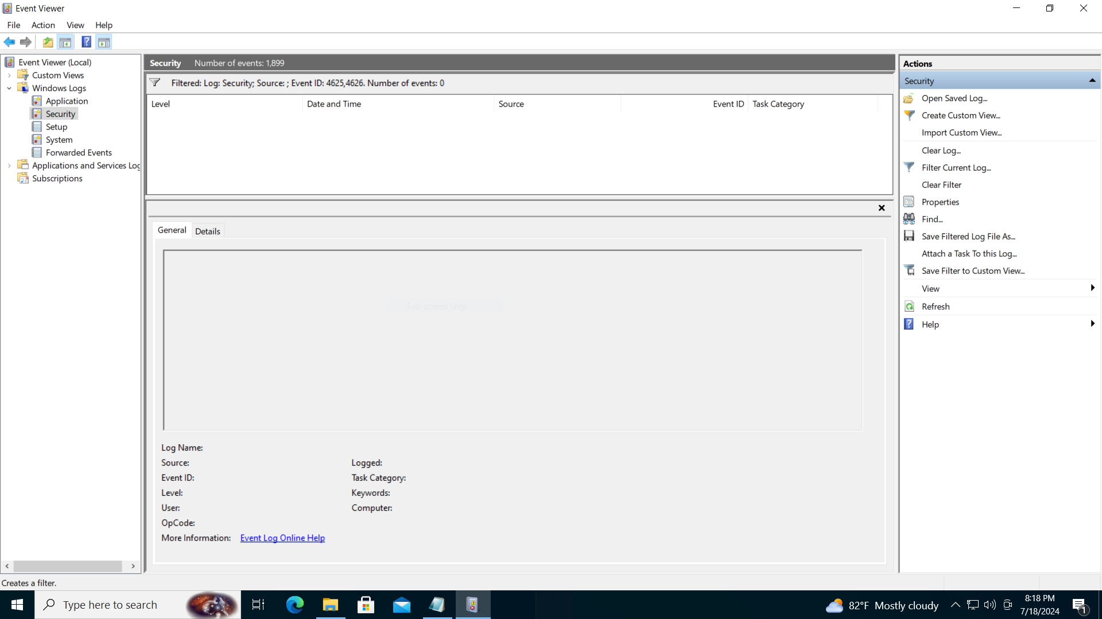
8. Logging RDP Attempts - Evidence
Place your screenshot below.

Slide 23

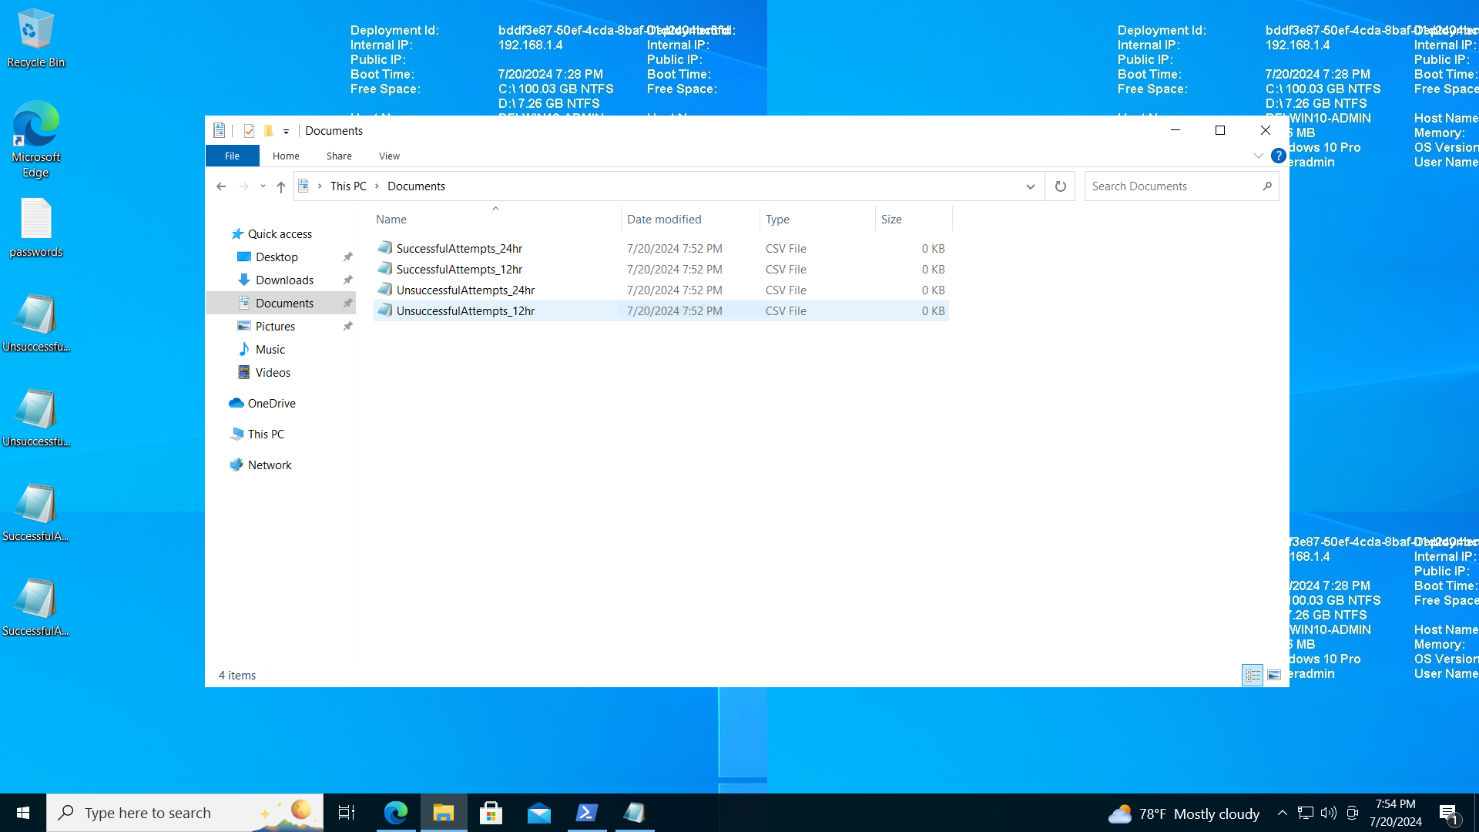
8. Logging RDP Attempts - Evidence
Place your screenshot below.

Slide 24
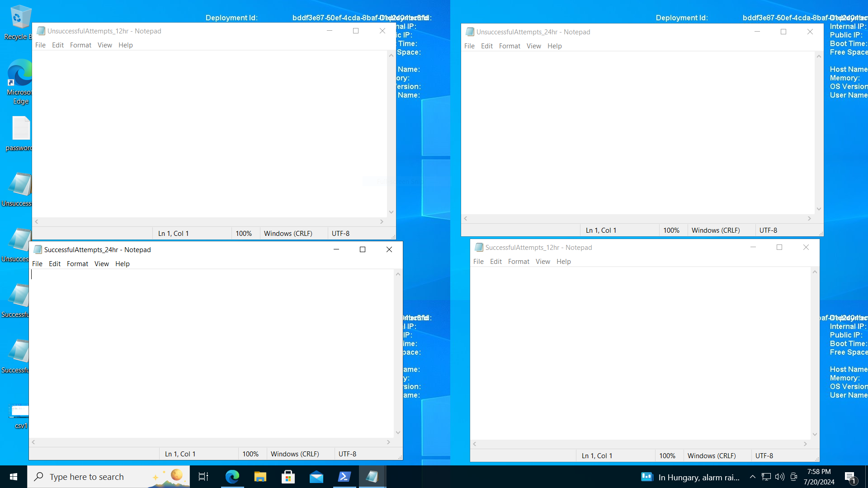
8. Logging RDP Attempts - Evidence
Place your screenshot below.

Slide 25
8. Logging RDP Attempts - Evidence
Write your 3-5 sentence explanation of your findings, recommendations, and justifications to the IT manager below.
 | Findings Upon examining the Windows Security Logs for Event IDs 4625 (failed login attempts) and 4626 (application or service starts), there were no records of unsuccessful login attempts via RDP on DFI-File-001 and DFI-File-002 in the past 24 and 12 hours, respectively. This indicates that there were no unauthorized or suspicious attempts to access the servers within the specified timeframes. Recommendations Continue Monitoring: Regularly monitor the security logs for any future unauthorized login attempts. Consider setting up real-time alerts to quickly respond to suspicious activities. Review Security Policies: Ensure that strong password policies are enforced and that RDP access is limited to only necessary personnel. Implementing multi-factor authentication (MFA) can add an extra layer of security. Network Security: Review firewall and security group settings to ensure that only trusted IP addresses can initiate RDP sessions. This can minimize the risk of external attacks. Justifications Proactive Measures: By continuing to monitor and review security policies, you can proactively prevent unauthorized access and potential security breaches. Access Control: Limiting RDP access and enforcing strong authentication methods ensure that only authorized users can access critical servers, reducing the risk of internal and external threats. Network Security: Strengthening network security settings helps protect the organization's infrastructure from potential cyber threats and unauthorized access, ensuring data integrity and confidentiality.

Slide 26
9. Windows Update - Instructions and Evidence
Using NIST 800-40r3 and Microsoft Security Update Guide, analyze the windows servers and provide your answers in the table below of available updates (KB and CVE) that should be installed as well as any updates that can be safely ignored for DFI's purpose. To assist, be aware that DFI is concerned with stability and security, any update that is not labeled as a 'critical' or 'security' can be left off. In the table below list at least 3 updates that should be installed and 3 updates that are not necessary.Justify your recommendations as to why you are making your choices. Tip: The severity of the updates can also help you decide the updates you’d like to install or ignore.
 | Available Updates | Update or Ignore? | Justification
 | KB5041019 | update | NET Framework updates are important for maintaining the security and performance of applications that rely on these frameworks. Installing this update helps ensure that any vulnerabilities in the .NET Framework are addressed.
 | KB5040427 | update | Cumulative updates are crucial as they include security and performance enhancements for Windows. These updates typically address vulnerabilities and bugs, providing a more secure and stable environment.
 | KB890830 | Update | This tool helps remove malicious software from your system. Keeping it updated ensures your system can detect and remove the latest threats, enhancing overall security.

Slide 27
9. Windows Update - Instructions and Evidence
Using NIST 800-40r3 and Microsoft Security Update Guide, analyze the windows servers and provide your answers in the table below of available updates (KB and CVE) that should be installed as well as any updates that can be safely ignored for DFI's purpose. To assist, be aware that DFI is concerned with stability and security, any update that is not labeled as a 'critical' or 'security' can be left off. In the table below list at least 3 updates that should be installed and 3 updates that are not necessary.Justify your recommendations as to why you are making your choices. Tip: The severity of the updates can also help you decide the updates you’d like to install or ignore.
 | Available Updates | Update or Ignore? | Justification
 | KB5001716 | Ignore | if newer cumulative updates (like KB5040427) are already being installed, previous monthly updates might be redundant. However, this depends on your system’s specific needs and any issues you might have experienced since May.
 | KB4023057 | Ignore | This update focuses on reliability improvements for Windows Update Service components. If your system is updating properly and you have newer updates queued, this one might not be necessary.
 | KB5033052 | ignore | As with the May update, if there are more recent cumulative updates being installed, this earlier update might not be essential unless you face specific issues related to this update's fixes.

Slide 28
10. Firewall Alert Response - Instructions and Evidence
The IT Manager took a look at firewall alerts and was concerned with some traffic she saw, please take a look and provide a mitigation response to the below firewall report. Remember to justify your mitigation strategy in 3 - 5 sentences. This file is available from the project resources title: DFI_FW_Report.xlsx. Please download and use this file to complete this task.
1 | Firewall mitigation response and justification goes here Block Malicious IP Addresses: Identify and block the IP addresses involved in the brute force attacks. For example, IPs like 192.34.57.157, 185.244.39.112, and 34.201.223.194 have been repeatedly attempting to authenticate via SSH. Blocking these IPs will prevent them from making further attempts. Implement Rate Limiting: Configure the firewall to limit the number of SSH login attempts from a single IP address within a certain time period. This helps to mitigate the impact of brute force attacks by slowing down or blocking excessive login attempts. Enable Geo-Blocking: If your organization does not need to accept SSH connections from certain regions, you can configure geo-blocking to restrict access from countries such as China, Russia, or South Africa, where many of these attempts originate. Strengthen Authentication: Implement multi-factor authentication (MFA) for SSH access to add an extra layer of security. This can significantly reduce the risk of unauthorized access even if the attacker successfully guesses or cracks the password. Monitor and Analyze Logs: Continuously monitor firewall and server logs for suspicious activities. Analyzing logs will help in identifying new patterns of attack and adjusting firewall rules accordingly.

Slide 29
11. Status Report and Next Steps - Instructions
As your first two weeks wind down, the IT Manager, HR Manager as well as other management are interested in your experience. With your position being the first dedicated Information Security role, they would like a 'big picture' view of what you've done as well as the security posture of DFI. Similar to Defense-in-Depth, an organization has multiple layers of security from the edge of their web presence all the way to permissions on a file. In 6-8 sentences, explain the work you've done, the recommendations made and how DFI should proceed from a security standpoint. This is your opportunity to provide a thoughtful analysis that shows your understanding of Cyber Security and how all of the tasks you've performed contribute to the security of DFI. As this will be reviewed by non-technical management please keep the technical jargon to a minimum. [Provide your Status Report on the next slide.]

Slide 30
12. Status Report and Next Steps - Instructions
[Provide your Status Report below.]
1 | Over the past two weeks, I've focused on strengthening DFI's overall security posture by addressing several critical areas. First, I analyzed firewall alerts and identified multiple instances of brute force attacks targeting our SSH services. In response, I recommended blocking the malicious IP addresses, implementing rate limiting for SSH access, and enabling multi-factor authentication (MFA). These measures are designed to prevent unauthorized access and enhance our defenses against potential breaches . Additionally, I've reviewed our network and system configurations to ensure they align with best security practices. I've also advised on the importance of continuous monitoring and updating our firewall rules to adapt to emerging threats. Going forward, DFI should consider expanding its security measures to include more comprehensive intrusion detection systems and regular security audits. By adopting these recommendations, we can significantly improve our ability to detect and respond to threats, ensuring a more robust and resilient security framework for the organization.

Slide 31
13. File Encryption
As your final task, assemble all of the deliverables you have created in Steps 1-12 and encrypt them using 7zip with a strong password. Password complexity: 15 or more characters and a combination of alphanumerics and special characters. When you submit the file you must also include your password as a note to the reviewer at Udacity or they will not be able to review your project.

Slide 32
Standout Suggestions

Slide 33
Standout Suggestion 1
Implementing a Security Awareness Training Program
1 | One of the most effective ways to enhance our organization's security posture is by implementing a comprehensive security awareness training program. Human error remains one of the leading causes of security breaches, and by educating our employees on recognizing and responding to threats, we can significantly reduce this risk. The training should cover key topics such as identifying phishing attempts, understanding the importance of strong passwords, and the protocols for reporting suspicious activity. By regularly updating the training materials to reflect the latest threats and engaging employees with interactive sessions, we can foster a culture of security awareness. This initiative not only empowers employees to become the first line of defense but also demonstrates our commitment to protecting both company and client data. By prioritizing education and awareness, we create a proactive defense strategy that strengthens our overall security framework.

Slide 34
Standout Suggestion 2
Deploying a Next-Generation Intrusion Detection System (IDS)
2 | To bolster our organization's security capabilities, I recommend deploying a next-generation intrusion detection system (IDS). Unlike traditional IDS solutions, a next-generation IDS utilizes advanced machine learning algorithms and behavioral analytics to detect and respond to threats in real-time. This system can analyze network traffic patterns and identify anomalies that may indicate potential security breaches, such as advanced persistent threats or zero-day exploits. By integrating the IDS with our existing security infrastructure, we can automate threat detection and response, reducing the time it takes to mitigate risks. Additionally, a next-generation IDS can provide valuable insights through comprehensive reporting and analytics, helping us to continuously improve our security posture. Implementing this technology will not only enhance our ability to protect sensitive data but also demonstrate our commitment to adopting cutting-edge solutions to safeguard our organization's assets.

